Slide 1
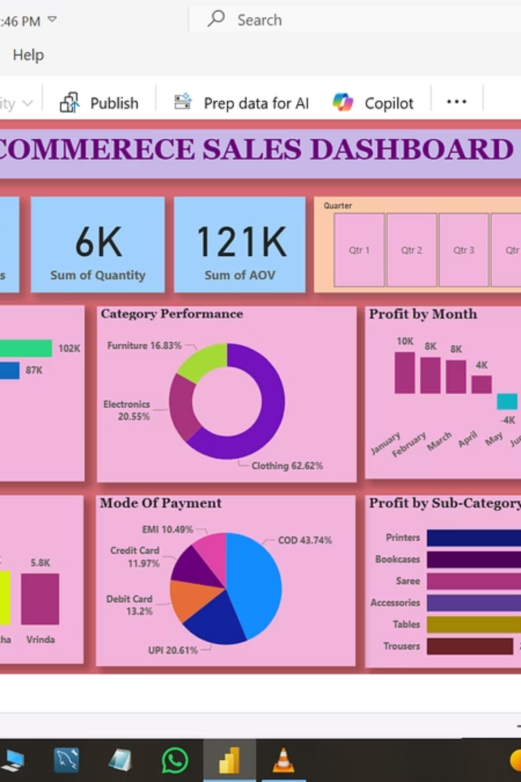
Dashboard Performance Insights
A comprehensive analysis of key metrics, performance indicators, and strategic insights derived from our dashboard data. This presentation provides actionable intelligence for informed decision-making.

Slide 2


Executive Summary: Key Performance Metrics
2.4M
87%
156
Total Revenue
Customer Satisfaction
Active Projects
Quarter-over-quarter growth demonstrating strong market performance
Exceeding industry benchmarks in service delivery
Diverse portfolio spanning multiple business segments
34%
YoY Growth
Consistent expansion across all major verticals
Our dashboard reveals exceptional performance across critical business dimensions. The data highlights sustained momentum in revenue generation, customer engagement, and operational excellence, positioning us favourably for continued growth in competitive markets.

Slide 3
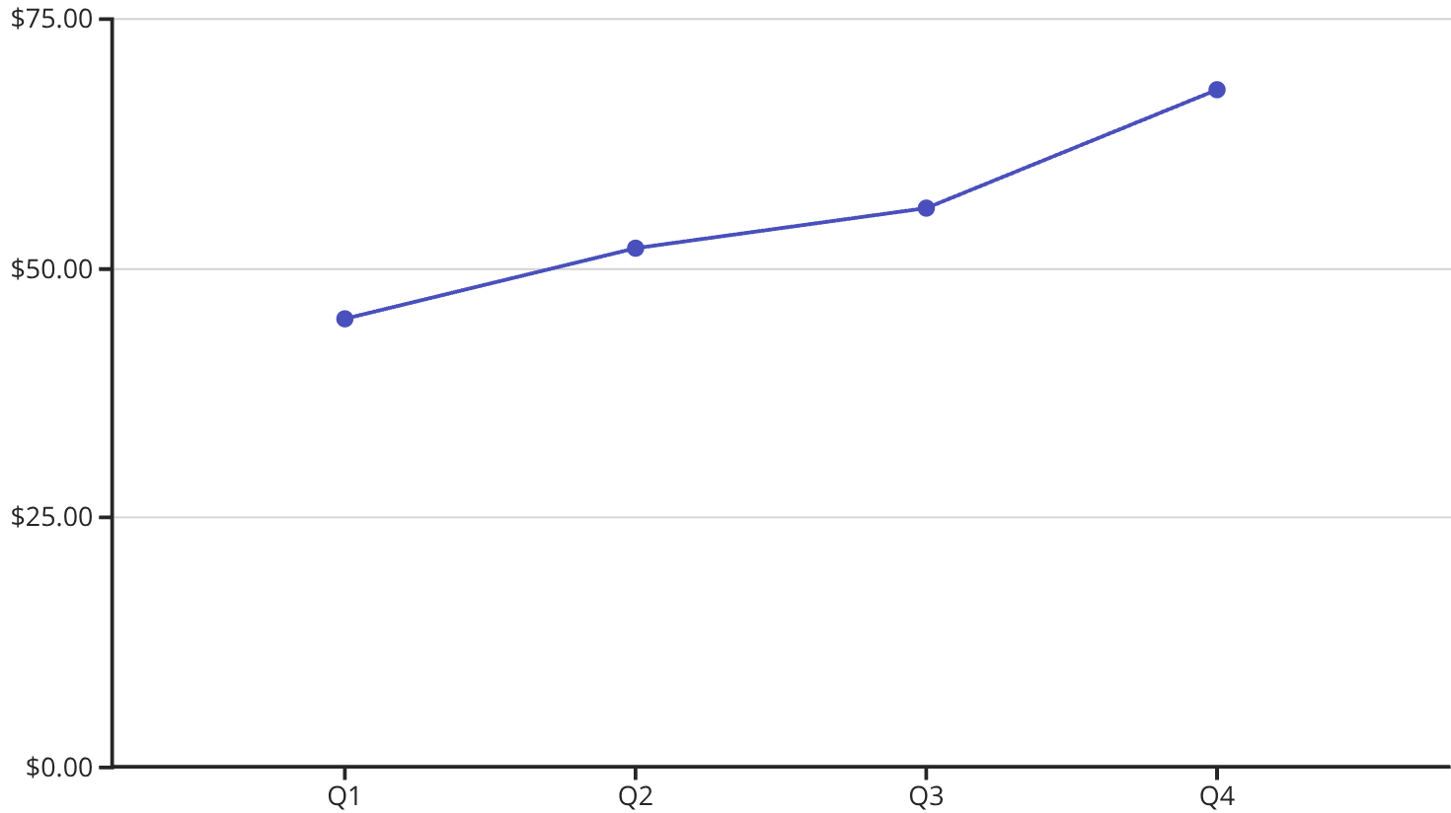
Revenue Trends and Financial Performance
Quarterly Revenue Analysis
The dashboard reveals consistent revenue growth throughout the fiscal year, with Q4 demonstrating exceptional performance at ₹68 lakhs, representing a 22% increase from Q3.
Key revenue drivers include:
Enhanced customer acquisition strategies
Improved product-market fit
Strategic pricing optimisation
Expansion into new market segments
This trajectory indicates strong market demand and effective go-to-market execution, supported by operational efficiency improvements.

Slide 4


Operational Efficiency Breakdown
Processing Time
Average transaction processing reduced by 34% through automation and workflow optimisation
Cost Efficiency
Operational costs decreased by 18% whilst maintaining service quality standards
Team Productivity
Employee output increased 27% with enhanced tools and streamlined processes
Quality Metrics
Error rates reduced by 41% through improved validation and quality controls
The dashboard highlights significant operational improvements across all functional areas. These efficiency gains translate directly to improved margins and enhanced customer experience.

Slide 5




Strategic Priorities for Next Quarter
Market Expansion
Launch operations in three new geographical regions with localised product offerings
Product Innovation
Release two major feature sets based on customer feedback and market research
Strategic Partnerships
Establish five key integrations to enhance platform value and ecosystem strength
Based on comprehensive dashboard analysis, these strategic priorities address identified growth opportunities whilst leveraging our existing strengths. Each initiative includes specific KPIs, resource allocation, and timeline commitments to ensure accountability and measurable progress. The focus remains on sustainable growth, customer value creation, and competitive differentiation in rapidly evolving markets.

Slide 6

Risk Factors and Mitigation Strategies
Market Competition
Risk: Increased competitive pressure from established players and new entrants
Mitigation: Accelerate product differentiation, strengthen brand positioning, enhance customer experience
Technology Disruption
Risk: Rapid technological changes may require platform modernisation
Mitigation: Continuous R&D investment, agile development methodology, technology partnerships
Regulatory Changes
Risk: Evolving compliance requirements across multiple jurisdictions
Mitigation: Proactive compliance monitoring, legal advisory engagement, flexible architecture design
The dashboard reveals several risk indicators requiring proactive management. Our mitigation strategies are designed to protect current performance whilst positioning us for long-term resilience.

Slide 7

Team Performance and Organisational Health
Employee Engagement
Our latest engagement survey shows 86% satisfaction rate, with particular strengths in work-life balance, career development opportunities, and team collaboration. This correlates directly with reduced turnover and improved productivity metrics visible in the dashboard.
Skills Development
Over 2,400 training hours completed this quarter across technical and leadership programmes. Upskilling initiatives have enhanced team capabilities in emerging technologies, project management, and customer-centric design thinking methodologies.
Diversity & Inclusion
Our commitment to building diverse teams shows measurable progress, with 43% representation from underrepresented groups and 38% women in leadership roles. Inclusive practices drive innovation and better decision-making across the organisation.

Slide 8
Key Takeaways and Action Items
01
02
Sustain Revenue Momentum
Enhance Customer Experience
Continue investing in high-performing channels and optimise conversion funnels to maintain 30%+ growth trajectory
Leverage engagement data to personalise user journeys and reduce friction points in the platform
03
04
Scale Operational Efficiency
Execute Strategic Priorities
Expand automation initiatives across additional workflows to further reduce costs and improve delivery speed
Allocate resources to market expansion, product innovation, and partnership initiatives with clear accountability
05
06
Monitor Risk Indicators
Invest in People
Implement early warning systems for identified risk factors and maintain agile response capabilities
Continue strengthening organisational health through development programmes, engagement initiatives, and inclusive practices
The dashboard data presents a compelling narrative of growth, efficiency, and strategic execution. By focusing on these action items, we position ourselves to capitalise on market opportunities whilst managing risks effectively. Regular dashboard monitoring will ensure we maintain alignment with objectives and adapt quickly to changing conditions.

